Slide 1

Virtual Reality TCS 675
Ms. Neha Sharma
Assistant Professor
Graphic Era Hill University, Haldwani
SOC Department

Slide 2
Course Outcomes
CO1: Demonstrate an understanding of techniques, processes,
technologies and equipment used in virtual reality
CO2: Identify appropriate design methodologies for immersive
technology development, especially from a physiological
perspective
CO3: Exploit the characteristics of human visual perception in
Virtual Reality techniques
CO4: Create effective VR techniques for the Web
CO5: Effectively categorize the benefits/shortcomings of
available VR technology platforms.
CO6: Use human factors to design and evaluate a VR application

Slide 3
Syllabus UNIT 1
Introduction: Goals, VR definitions, Birds-eye view (general, hardware, software, sensation and perception), Defining Elements of Virtual Reality, Applications of VR, Technical framework, Mixed and Augmented Reality
Depth Perception: Monocular and Binocular Cues, Panoramas Motion Perception, Frame rates and displays

Slide 4
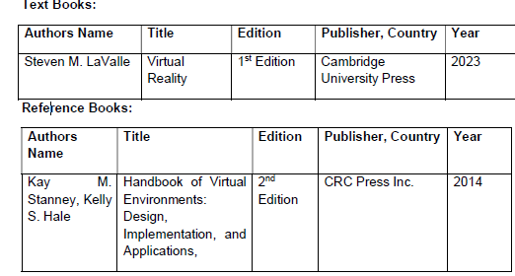
VR
vrbook.pdf

Slide 5
Virtual Reality Applications
Automotive industry
https://youtu.be/5EAa3H8LP5k
2. Interior design
https://youtu.be/dmahvy5sf6o
3. Learning and development
https://youtu.be/qvsafcxL0Ng
4. Fitness
https://youtu.be/MnvRVJMzhiA

Slide 6
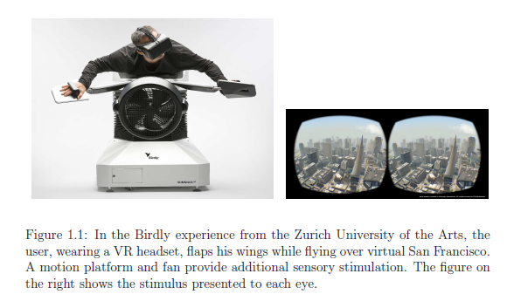
VR
Definition : Inducing targeted behavior in an organism by using artificial sensory stimulation, while the organism has little or no awareness of the interference.

Slide 7
Four key components in the definition
Targeted behavior: The organism is having an “experience” that was designed by the creator. Examples include flying, walking, exploring, watching a movie, and socializing with other organisms.
Organism:This could be you, someone else, or even another life form such as a fruit fly, cockroach, fish, rodent, or monkey
Artificial sensory stimulation: one or more senses of the organism become co-opted, at least partly, and their ordinary inputs are replaced or enhanced by artificial stimulation.
4. Awareness: the organism seems unaware of the interference,
thereby being “fooled” into feeling present in a virtual world.
This unawareness leads to a sense of presence in an altered or
alternative world. It is accepted as being natural.

Slide 8
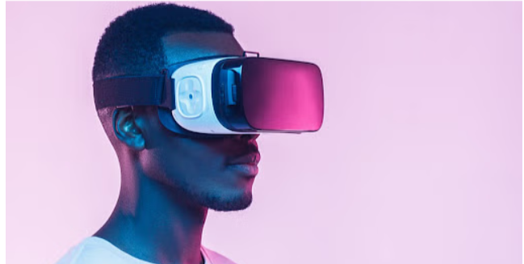
VR is a self-controlled environment where the user can control the simulated environment via a system.
VR enhances a fictional environment by using sensors, displays, and other features like motion tracking, Movement tracking, etc.
VR enhances the user experience to the next level via VR headsets or other VR devices like Oculus quest 2, Hp reverb G2, etc.

Slide 9
it specifically refers to computer generated imagery and hardware specifically designed to bring those sights and sounds to us in a way that is totally immersive.
How Does Virtual Reality Technology Work?
Virtual reality is a technique that simulates vision to create a 3D world in which the user appears to be immersed while surfing or experiencing it. The user experiencing the 3D world then controls it in full 3D. On the one hand, the user creates 3D VR settings, while on the other, he experiences or explores them using suitable equipment such as VR headsets.

Slide 10
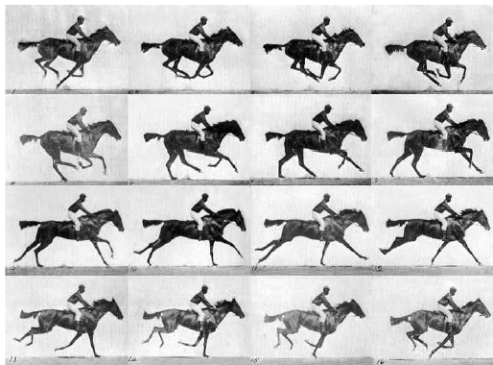
History
Moving pictures
Video games
VR headsets

Slide 11
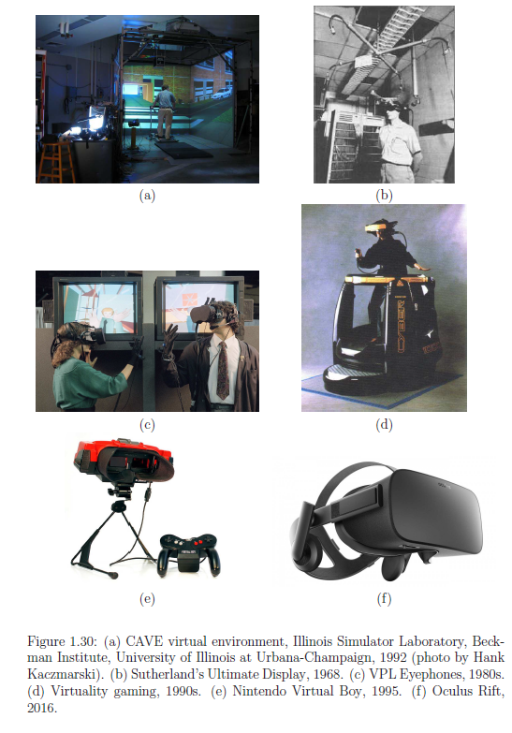

Slide 12
Software's
Viewit3D: Viewit3D is an Augmented Reality (AR) and 3D product visualisation solution in one.
Unity: It is a game creation programme that allows organisations to create and distribute 2D, 3D, and virtual reality (VR) apps across several platforms.
LiveTour: LiveTour is an immersive virtual tour developer that can capture any environment in 360° VR for presentations to prospective customers, guests, or purchasers.

Slide 13
Goals of VR
Immersion: The whole reason someone wears a VR headset is to transport themselves to a simulated world that is even more engrossing than watching a movie or playing a game with surround sound.
Comfort: No matter how immersive the technical components of a VR showcase are, a person’s immersion will be shattered if they become uncomfortable. VR headsets, Motion controls and motion sickness also provide challenges for some users.
New Gameplay Experiences: virtual reality can add many fun elements to games that simply wouldn’t translate over to traditional button controls.
Education and Learning: Students can visit and even walk around digital recreations of historic places and events.

Slide 14
Goals of VR
5. Specialized Job Training: There are many jobs that require immense precision and accuracy. Occupations such as Surgeon are difficult to train for because of the delicate nature of the work. VR can be used to train people for these roles without putting anyone’s life in danger.
6. Healing and Confronting Mental Trauma: One of the best ways to handle mental and emotional trauma is to confront it directly. Medical professionals have been using exposure therapy to help patients overcome their fears and even reduce symptoms of PTSD. By recreating the source of trauma in a safe virtual space

Slide 15
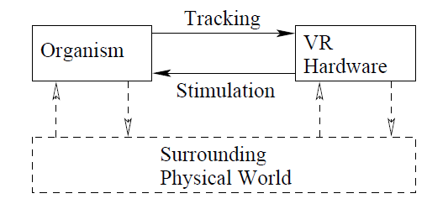
Birds-eye view (general, hardware, software, sensation and perception)
It presents an overview of VR systems from h/w to
software to human perception
##The hardware
produces stimuli that override the senses of the user.
The VR hardware accomplishes this by using its own sensors, thereby tracking motions of the user.

Slide 16
Birds-eye view
a. Sensors and sense organs :The “sensor” is called a sense organ, with common examples being eyes and ears.
A sensor is a special transducer that converts the energy it receives into a signal for an electrical circuit. A sensor typically has a receptor that collects the energy for conversion

Slide 17
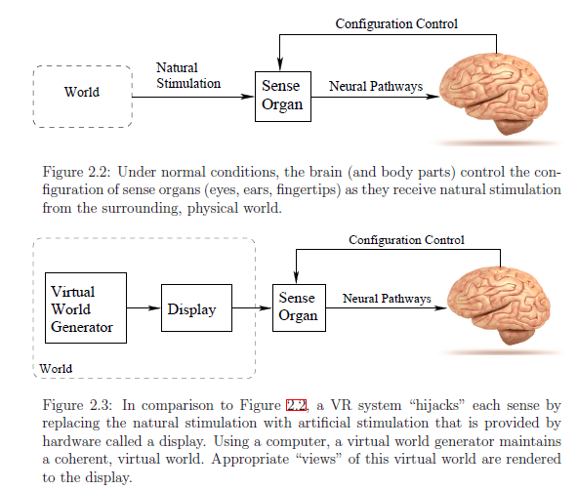
Birds-eye view

Slide 18
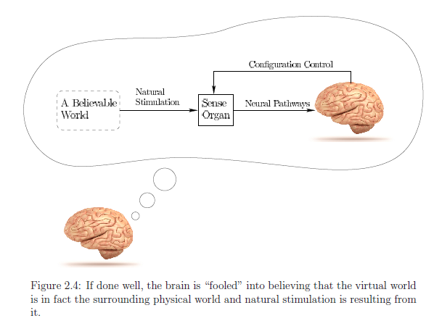
Birds-eye view

Slide 19
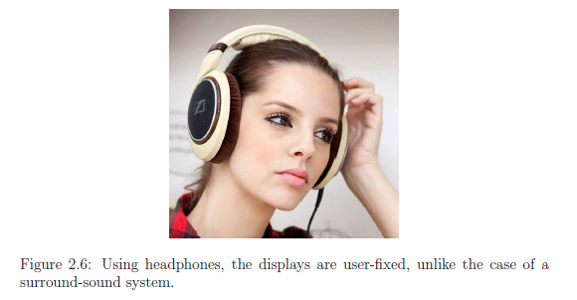
Birds-eye view
Aural: world-fixed vs. user-fixed:
In the surround-sound system, the generated sound (or stimulus) is far away from the ears, whereas it is quite close for the headphones.
One implication of the difference in distance is that much less power is needed for the headphones to generate an equivalent perceived loudness level compared with distant speakers.
Another implication based on distance is the degree of privacy allowed by the wearer of headphones. A surround-sound system at high volume levels could generate a visit by angry neighbors.
Wearing electronics on your head could be uncomfortable over long periods of time, causing a preference for surround sound over headphones.

Slide 20
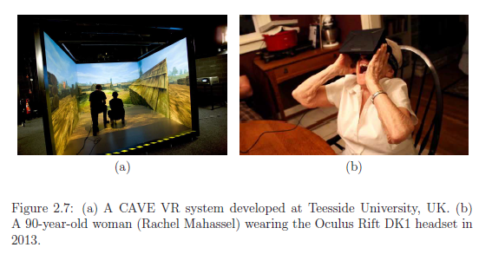
Birds-eye view
Visual: world-fixed vs. user-fixed
The surrounding virtual world should be counter-rotated,

Slide 21
Birds-eye view
The hardware components of VR:
Displays (output): Devices that each stimulate a sense organ. For headsets, a smartphone display can be placed close to the eyes and brought into focus using one magnifying lens for each eye. Sound is displayed to the ears using classic speaker technology. Bone conduction methods may also be used, which vibrate the skull and propagate the waves to the inner ear For the sense of touch, there are haptic displays. Haptic feedback can be given in the form of vibration, pressure, or temperature.
Sensors (input): Devices that extract information from the real world.

Slide 22
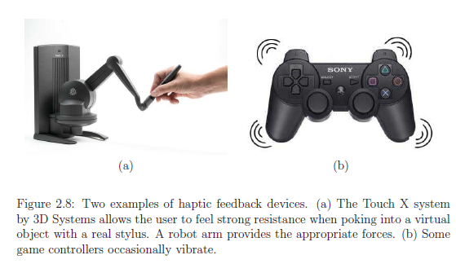
Birds-eye view

Slide 23
Birds-eye view
Sensors Consider the input side of the VR hardware: mainly used for tracking the user’s head orientation.
Computers: Devices that process inputs and outputs sequentially.
A computer executes the virtual world generator (VWG). we expect to see wireless, all-in one headsets that contain all of the essential parts of smartphones for delivering VR experiences.
Graphical processing units (GPUs) have been optimized for quickly rendering graphics to a screen and they are currently being adapted to handle the specific performance demands of VR.

Slide 24
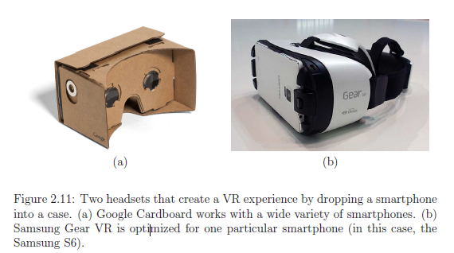
Birds-eye view

Slide 25
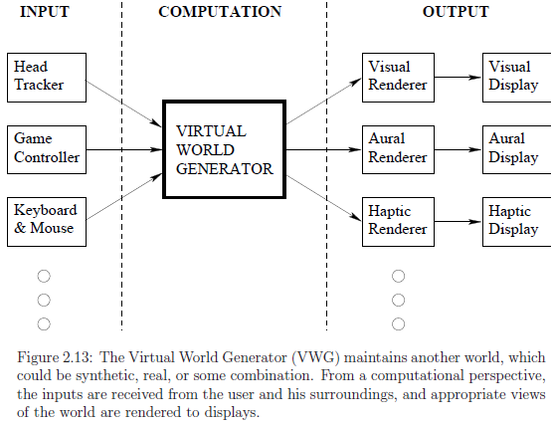
Birds-eye view
##Software:

Slide 26
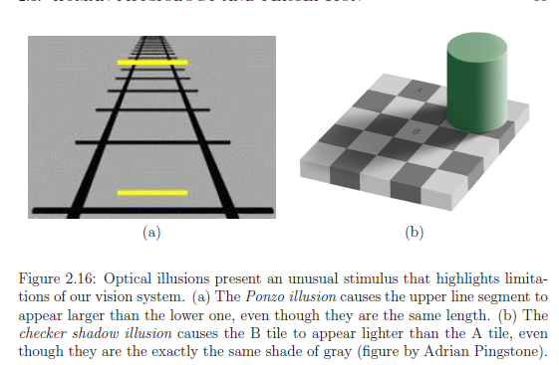
Birds-eye view
##Human Physiology and Perception:

Slide 27
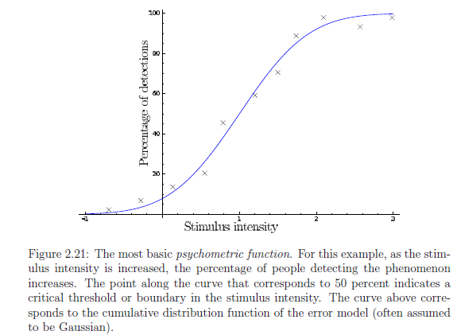
Birds-eye view
##Human Physiology and Perception:
Perception happens after the sense organs convert the stimuli into neural impulses. Another important factor in perception and overall cognitive ability is the interconnection between neurons

Slide 28
Elements of Virtual Reality
The four key elements of a virtual reality experience are immersive visuals, realistic audio, interactive environments, and natural interaction methods such as motion tracking or hand controllers.
Types of Virtual Reality (VR)
On the basis of the most important feature of VR i.e. immersion and the types of systems and interfaces used, The VR systems can be classified into 3 types :
Immersive
Semi-immersive
Non – immersive

Slide 29
Elements of Virtual Reality
Immersive: immersive visuals, realistic audio, interactive environments, and natural interaction . Tools and gadgets used in this system are advanced and not so common to use.
Semi-immersive: immersive visuals, realistic audio, interactive environments, and natural interaction . Tools and gadgets used in this system are common to us and utilize physical models.
Non – immersive: Non-immersive VR system is the least immersive and least immersive VR system. It is not expensive to use this system. gadgets used are limited to glasses and display monitors and it uses the least expensive components.

Slide 30
Applications of VR
Healthcare :
Surgeries: Surgeons can practice operations in a virtual environment to improve their skills and reduce risk.
Therapy: VR can be used for therapeutic purposes in healthcare.
2. Education:
Teaching:VR can provide students with insights into environments that are hard to access.
Learning:VR can create realistic simulations to help students learn in a safe environment.

Slide 31
Applications of VR
3. Entertainment:
Gaming: VR gaming allows players to interact with virtual characters and environments.
Movies: VR can enhance the audience experience for movies.
4. Architecture
Interior design: VR can help homeowners and designers visualize details of a room, such as lighting, furniture placement, and color schemes.
Urban design: VR can be used for architectural and urban design.

Slide 32
Applications of VR
5.Tourism
Virtual tours: VR can be used to capture tourism destinations and create immersive virtual tours.
Other applications industrial design, engineering and robotics, digital marketing and activism, occupational safety, and social science and psychology.

Slide 33
Technical framework
A typical virtual reality (VR) technical framework consists of: a 3D graphics engine to render virtual environments, motion tracking systems to capture user movement, input devices like controllers or hand tracking to interact with the virtual world, a head-mounted display (HMD) to present the visuals to the user, and software to manage the integration of these components, all while maintaining low latency for a seamless experience; advanced VR systems may also incorporate haptic feedback for tactile sensations and spatial audio for immersive sound design.
Key components of a VR framework:
1 3D Graphics Engine: Renders the virtual environment

Slide 34
Technical framework
2. Motion Tracking System:
Tracks the user's head and hand movements in real-time using sensors like cameras, gyroscopes, and accelerometers.
3. Input Devices:
Controllers:Handheld devices with buttons and joysticks allowing for user interaction with virtual objects.
Hand Tracking: Advanced systems that track hand movements without the need for dedicated controllers.
Motion Capture Suits: Full-body tracking systems for complex movement simulation.
4. Head-Mounted Display (HMD)
5. Software Framework:
Manages the communication between all VR components, including input handling, rendering, and scene management.

Slide 35
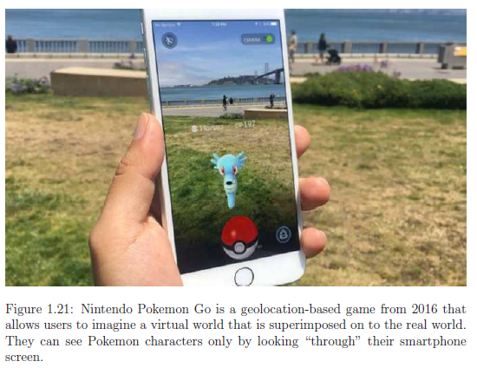
Mixed and Augmented Reality
the live, real world with some additional graphics superimposed to enhance its appearance, By placing text, icons, and other graphics into the real world, the user could leverage the power of the Internet to help with many operations such as navigation, social interaction, and mechanical maintenance

Slide 36
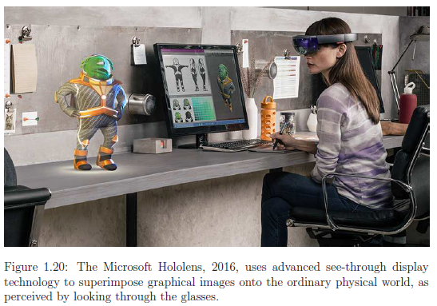
Mixed and Augmented Reality
These applications rely heavily on advanced computer vision techniques, which must identify objects, reconstruct shapes, and identify lighting sources in the real world before determining how to draw virtual objects that appear to be naturally embedded.

Slide 37
Mixed and Augmented Reality
Several possibilities exist for visual displays. A fixed screen should show images that are enhanced through 3D glasses. A digital projector could augment the environment by shining light onto objects, giving them new colors and textures, or by placing text into the real world. A handheld screen, which is part of a smartphone or tablet could be used as a window into the augmented or mixed world.
advanced see-through display technology include Google Glass, Microsoft Hololens, and Magic Leap.

Slide 38
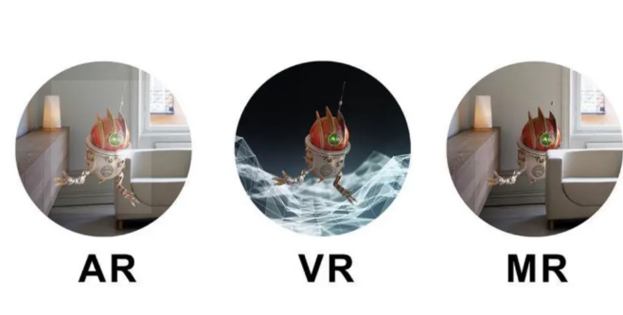
Mixed and Augmented Reality

Slide 39
Depth Perception
It explains how humans judge the distance from their eyes to objects in the real world using vision. The perceived distance could be metric, For example, a house may appear to be about 100 meters
Depth perception refers to the ability to see the world in 3D and judge how far away/close objects are from and to us.
How we move from one point to another relies quite heavily on our ability to perceive depth, and even picking up an object, such as your pencil, relies on the ability to judge depth.
For example, if we were crossing the road and couldn't judge how far away a car was, it would be a bit of a disaster.
Monocular vs. stereo cues : A piece of information that is derived from sensory stimulation and is relevant for perception is called a sensory cue or simply a cue.
If a depth cue is derived from the photoreceptors or movements of a single eye, then it is called a monocular depth cue. If both eyes are required, then it is a stereo depth cue.

Slide 40
Depth Perception:
Monocular depth cues: information about the depth that can be judged using only one eye.
Monocular depth cues can be used in pictures, many monocular depth cues are used in art to give viewers a sense of depth. Examples
Height in plane
Relative size
Occlusion
Linear perspective
Binocular depth cues: information about depth that uses both eyes to see and understand 3D space; this is much easier for our brains to comprehend than monocular depth cues.
Convergence
2. Retinal Disparity

Slide 41

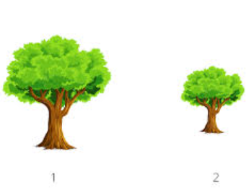
Depth Perception:

Slide 42
Depth Perception:
Height in plane: Height in plane is when objects placed higher up appear or would be interpreted as further away.
Relative size: If there are two objects that are the same size (e.g., two trees of the same size), the object that is closer will look larger.

Slide 43
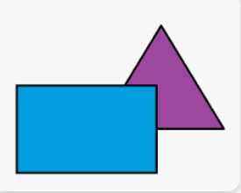

Depth Perception:
3. Occlusion: This is when one object partially hides another object. The object in front overlapping the other is perceived to be closer than the partially hidden one.
4. Linear perspective: This is when two parallel lines come together at some point in the horizon; the closer together the two lines are, the further away they seem.

Slide 44

Binocular Depth Cues – Types and Examples
1. Convergence: To present images of what we see onto the retinas (the layer of tissue at the back of the eyes that sense light and transports images to the brain), the two eyes must rotate inwards toward each other. The closer an object is, the more the eyes must rotate.
Your brain would be able to tell how close the object was to your face by detecting how much your eyes were 'crossing', using the muscles.

Slide 45
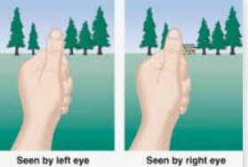
2. Retinal Disparity
When we see something, slightly different images of what we see are sent to each retina (as our eyes are apart, each eye sees things from a slightly different angle).
The disparity between the two images allows the brain to calculate how far away an object is. An object close to us has a large disparity, and an object far away has a small disparity.

Slide 46
Panoramas Motion Perception
Motion also helps people to assess the 3D structure of an object.
perception of motion is the perception of non motion, which we called perception of stationary
Motion perception is a crucial aspect of how we interpret and interact with our environment. It allows us to understand the movement of objects in three-dimensional (3D) space, which is essential for tasks such as avoiding obstacles and navigating through our surroundings.
This type of a cue called "motion parallax"

Slide 47
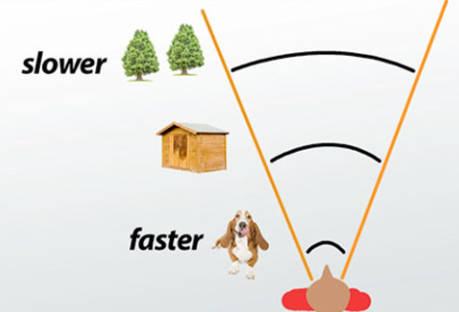

Slide 48
Motion parallax:
This is the primary way motion perception contributes to depth perception; when you move, closer objects appear to move faster across your vision than farther objects, providing a strong cue about their relative distance.
Closer objects leave the visual field faster, whereas the farther objects stay in our visual field longer. The farther away we look, the wider our visual field extends. For instance, you are looking out of a car window. You notice that the silver pole appears to move fast, while the white apartment stays in view. This is because the silver pole is closer to you than the white building. This creates the motion parallax.

Slide 49
Frame rates and displays
A "frame rate" refers to the number of individual images (frames) displayed on a screen per second, measured in frames per second (FPS), and is a crucial factor in how smooth motion appears on a display
Standard frame rates:
24 FPS: Commonly used for cinematic film, considered natural to the human eye
30 FPS: Standard for most video content, including live TV and many online videos
60 FPS: Considered a good balance for gaming and smooth video playback
Higher FPS (120, 144): Primarily used for competitive gaming where extremely fast reactions are needed

Slide 50
Improving Latency and Frame Rates:
The motion-to-photons latency in a VR headset is the amount of time it takes to update the display in response to a change in head orientation and position.
Let d be the density of the display in pixels per degree. Let ω be the angular velocity of the head in degrees per second. Let ℓ be the latency in seconds. Due to latency ℓ and angular veloci
For example, if d = 40 pixels per degree, ω = 50 degrees per second, and ℓ = 0.02 seconds, then the image is incorrectly displaced by dωℓ = 4 pixels. An extremely fast head turn might be at 300 degrees per second, which would result in a 24-pixel error.ty ω, the image is shifted by dωℓ pixels.

Slide 51
The perfect system: As the head moves, the viewpoint must accordingly change for visual rendering.
The VWG continuously maintains the positions and orientations of all objects in the virtual world
The display has retina-level resolution and a dynamic range of light output over seven orders of magnitude to match human perception.
visual stimulation provided by the virtual world should match what would occur in a similar physical world in terms of the geometry. There would be no errors in time and space
In early VR systems, the total motion-to-photons latency was often over 100ms. In the 1990s, 60ms was considered an acceptable amount. Latency has been state as one of the greatest causes of VR sickness
latency is no longer the main problem in most VR systems because of the latest-generation tracking, GPU, and display technology. The latency may be around 15 to 25ms

Slide 52
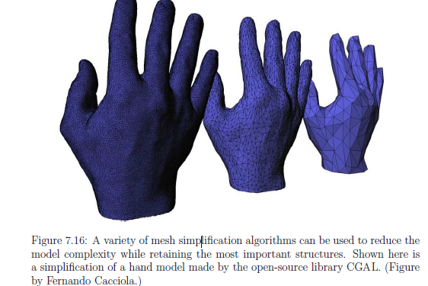
Overview of latency reduction methods:
1. Lower the complexity of the virtual world.
2. Improve rendering pipeline performance.
3. Remove delays along the path from the rendered image to switching pixels.
4. Use prediction to estimate future viewpoints and world states.
5. Shift or distort the rendered image to compensate for last-moment viewpoint errors and missing frames
the virtual world is composed of geometric primitives, which are usually 3D triangles arranged in a mesh. The chain of transformations and rasterization process must be applied for each triangle, resulting in a computational cost that is directly proportional to the number of triangles
a modeling tool such as Maya or Blender will automatically construct a highly accurate mesh of triangles over a curved surface.

Slide 53
For dynamic worlds, the VWG maintains a simulation of the virtual world that moves all geometric bodies while satisfying physical laws that mimic the real world. It must handle the motions of any avatars, falling objects, moving vehicles, swaying trees, and so on.
Collision detection methods are needed to make bodies react appropriately when in contact
Thus, the VWG has a frame rate in the same way as a display or visual rendering system. Each VWG frame corresponds to the placement of all geometric bodies for a common time instant

Slide 54
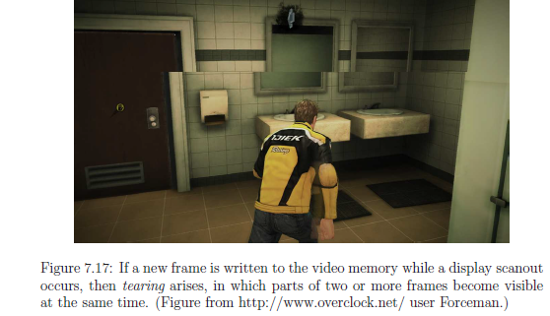
From rendered image to switching pixels The problem of waiting for coherent VWG frames also arises in the process of rendering frames to the display:
One solution to this problem to use vsync (pronounced “vee sink”), which is a flag that prevents the video memory from being written outside of the vblank interval.
Another strategy to avoid tearing is buffering, The approach is simple for programmers because it allows the frames to be written in memory that is not being scanned for output to the display.

Slide 55
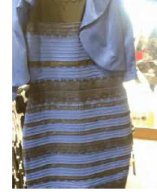
Perception of Color
dress color illusion: About 57% perceive it as blue
and black (correct), 30% percent perceive it as white and gold, 10% perceive blue and brown, and 10% could switch between perceiving any of the color combinations
Displays generally use RGB lights to generate the palette of
colors and brightness.

Slide 56
Implications for VR: How good does the VR visual display need to be?
Three crucial factors for the display are:
1. Spatial resolution: How many pixels per square area are needed?
2. Intensity resolution and range: How many intensity values can be produced, and what are the minimum and maximum intensity values?
3. Temporal resolution: How fast do displays need to change their pixels?

Slide 57
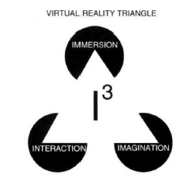
THE THREE I's OF VIRTUAL REALITY
Virtual reality is not just a medium or a high-end user interface, it also has applications that involve solutions to real problems in engineering, medicine, the military, etc.
The extent to which an application is able to solve a particular problem, that is, the extent to which a simulation performs well, depends therefore very much on the human imagination, the third "I" of VR.

Slide 59
https://virtualspeech.com/blog/vr-applications
https://www.simplilearn.com/tutorials/artificial-intelligence-tutorial/what-is-virtual-reality#what_is_virtual_reality
https://www.theknowledgeacademy.com/blog/virtual-reality-interview-questions/

